Slide 1
Phylodynamics of SARS-CoV-2
Julia A. Palacios
Department of Statistics
Department of Biomedical Data Science
Stanford University

Slide 2
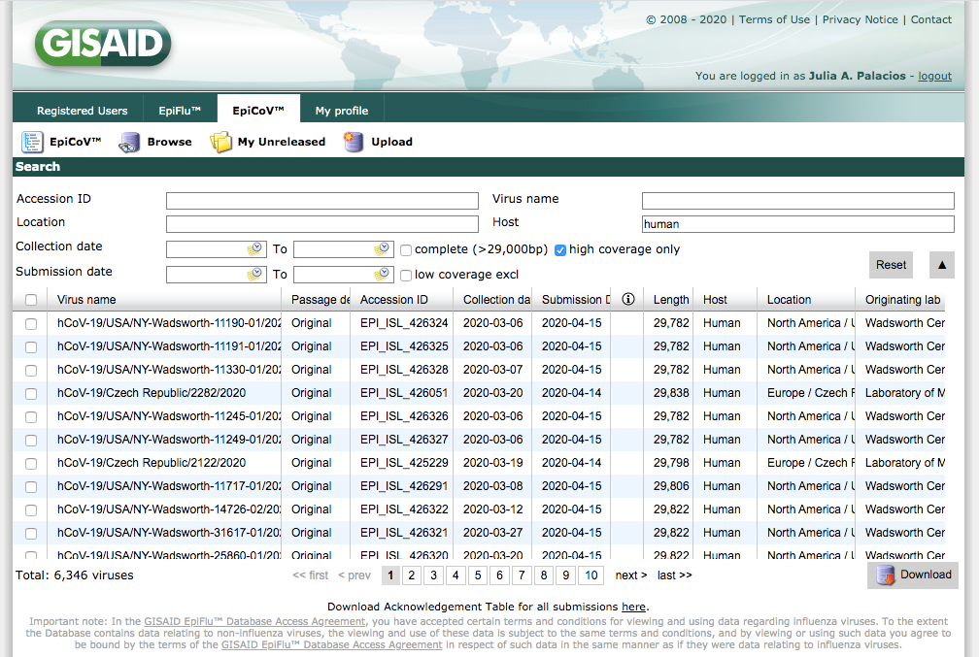
Phylodynamics of SARS-CoV-2
The goal is to understand:
Patterns of transmission and spread (effective population size)
Mutation rate
Comparison to other coronaviruses
Is there human recombination?
Selection?
Surveillance
Gisaid Data: 501 sequences from 33 countries
All the data used here is provided by the laboratories that kindly shared data in GISAID EpiCoV dataset.
Data pre-processing follows nextstrain/ncov

Slide 3
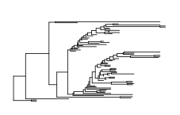
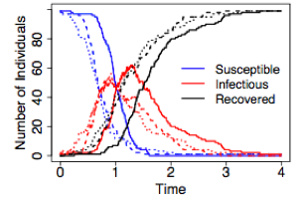

Phylodynamics of SARS-CoV-2
Genetic Diversity
Phylogenetics
Population Dynamics
Epidemiology
Immunology
and
Genetics

Slide 4
Molecular data of SARS-CoV-2
80 countries

Slide 5
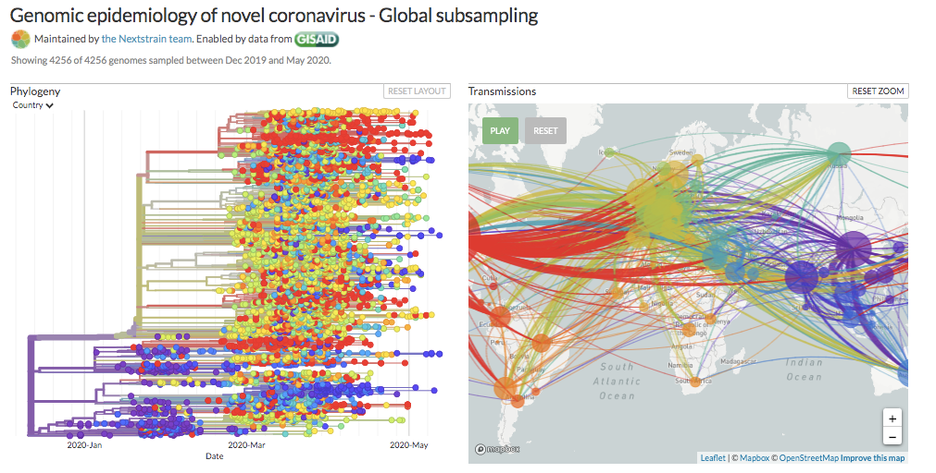
Global spread of SARS-CoV-2

Slide 6
Molecular data of SARS-CoV-2
Lagged reporting in Gisaid data

Slide 7
Molecular data of SARS-CoV-2
~92.6% of the sites are monomorphic, ~7% are binary

Slide 8
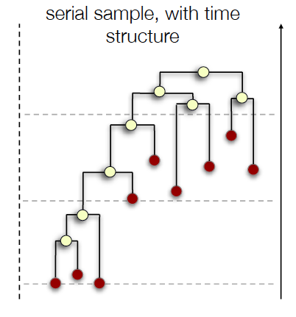
Phylodynamic Data
Viral genomes of SARS-CoV-2 are sampled at different points in time and from different locations
Transmission history can be estimated on a real time-scale (weeks)
We can detect evolutionary differences among sampled sequences because:
High substitution rate
Time between samples
Sequence length of the genome
Dec 2019
Jan 2020
Feb 2020

Slide 9
Molecular data of SARS-CoV-2
Data quality is challenging

Slide 10
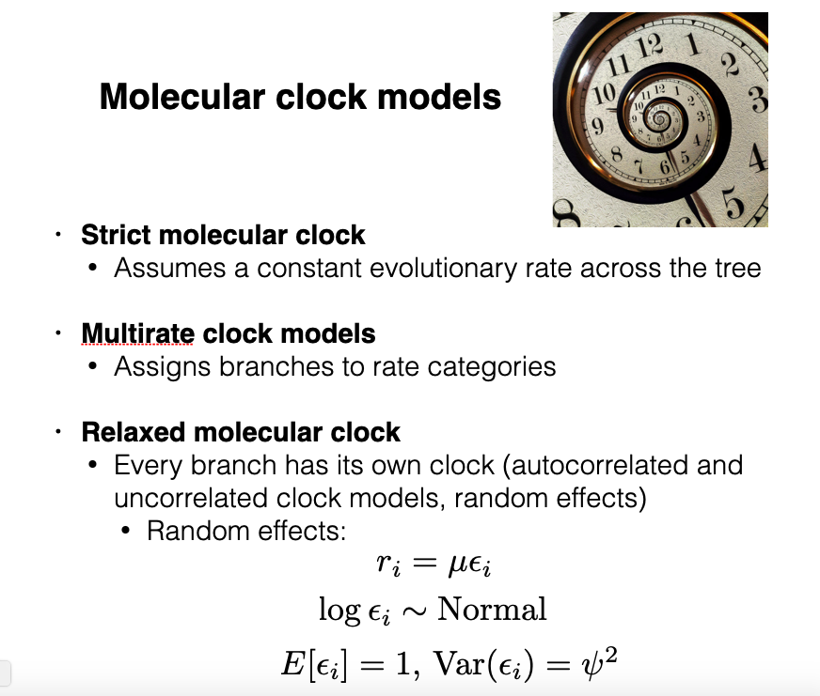

Slide 11
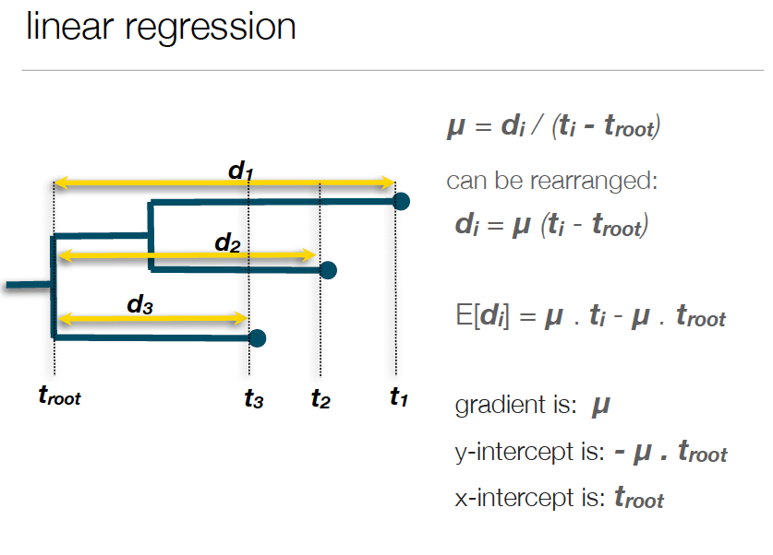
Rough estimation of substitution rate

Slide 12
Rough estimates of substitution rate
*Assumes constant effective population size and independence, ignores population structure
and sequencing errors

Slide 13
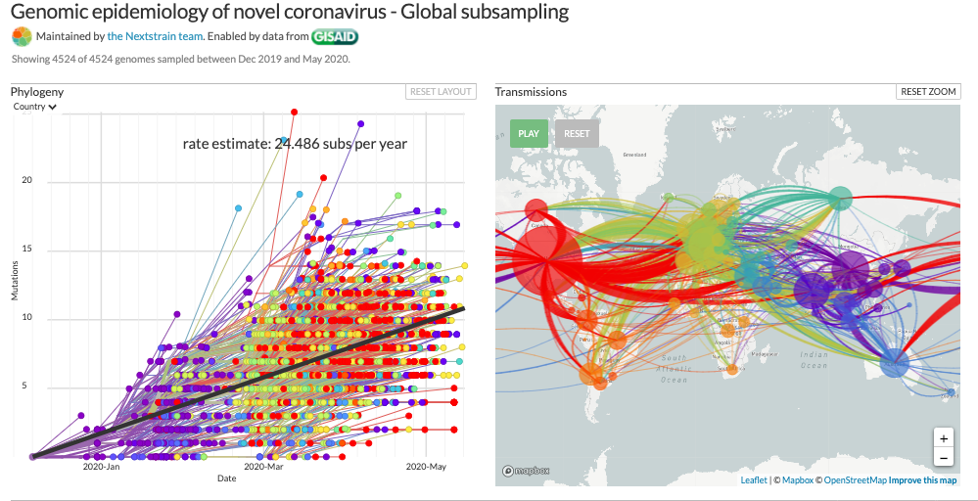
Rough estimates of substitution rate

Slide 14
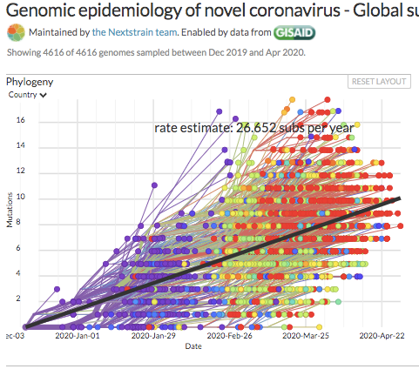
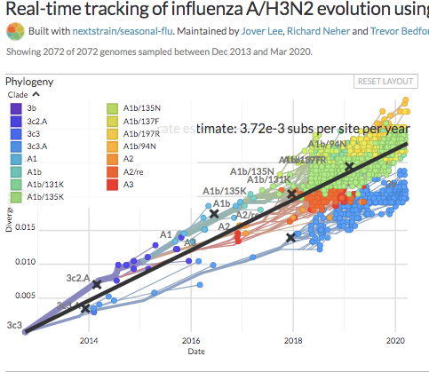
Rough estimates of substitution rate
SARS-CoV-2 – whole genome
Influenza A/H3N2 – HA segment

Slide 15
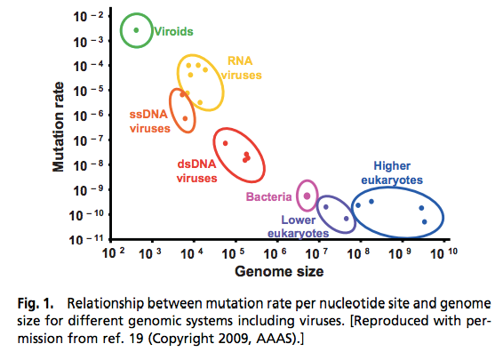
Rough estimates of substitutions rate
[Gago et al., Science 06 Mar 2009]

Slide 16
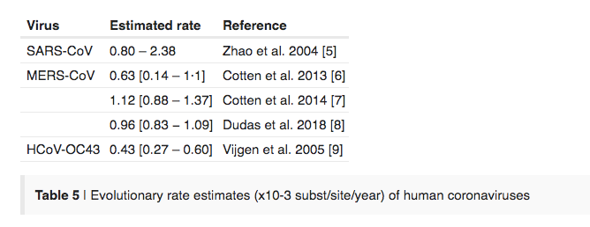
Estimates are compatible with other coronavirus mutation rates
Source: http://virological.org/t/phylodynamic-analysis-176-genomes-6-mar-2020/356

Slide 17
Phylodynamics of SARS-CoV-2
The goal is to understand:
Patterns of transmission and spread (effective population size)
Mutation rate
Comparison to other coronaviruses
Is there human recombination?
Selection?
Surveillance
Gisaid Data: 501 sequences from 33 countries
All the data used here is provided by the laboratories that kindly shared data in GISAID EpiCoV dataset.
Data pre-processing follows nextstrain/ncov

Slide 18
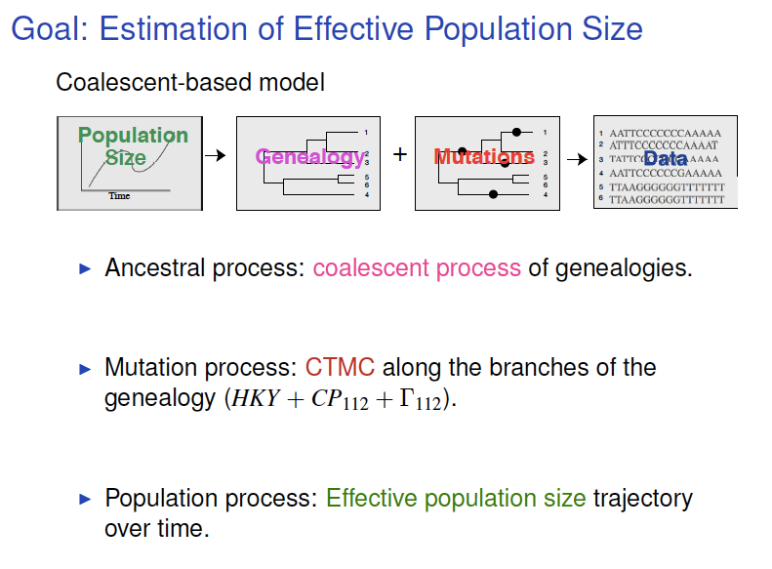

Slide 19
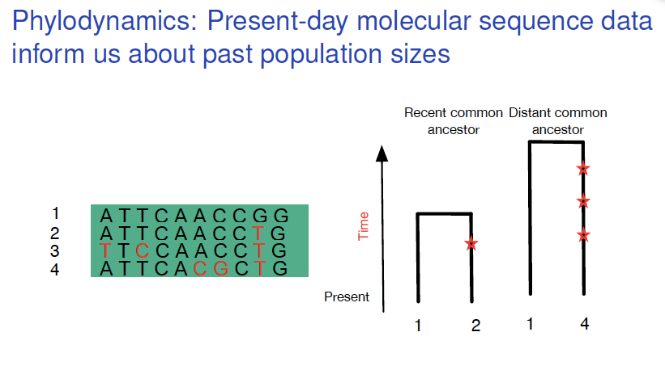
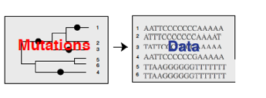

Slide 20
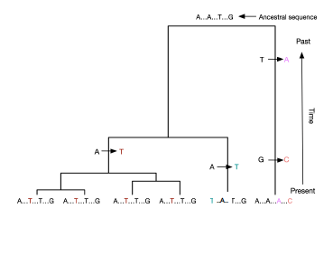
A process of substitutions is superimposed on the genealogy

Slide 21
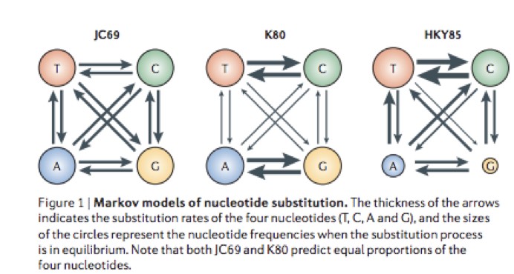
A process of substitutions is superimposed on the genealogy
Transversions < transitions

Slide 22
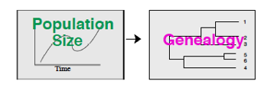
Genealogy branch lengths depend on population dynamics (neutral theory)
Assumptions:
Evolution is neutral – tree topology and branch lengths are independent.
We have a random sample from a large population.
No population structure

Slide 23
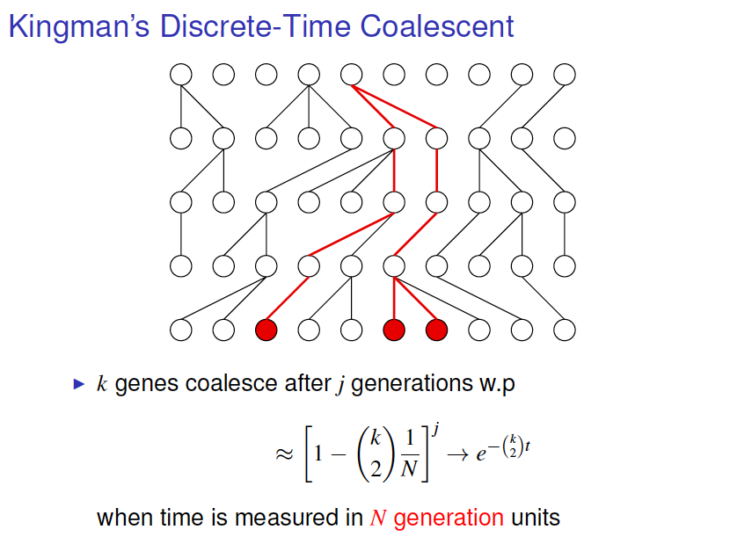

Slide 24
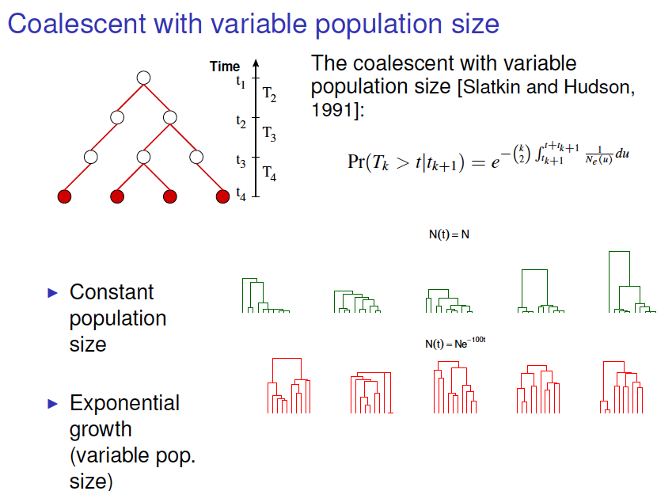

Slide 25
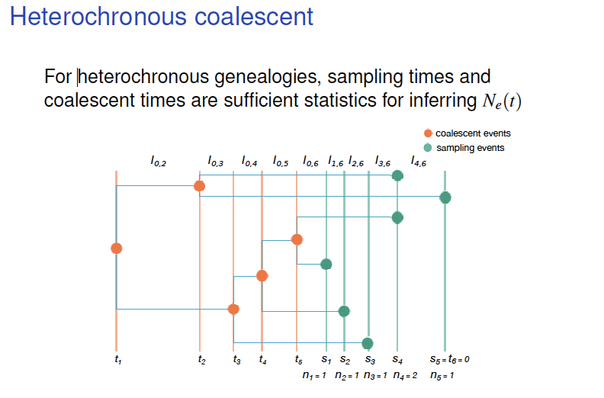
(Felsenstein and Rodrigo, 1999)

Slide 26
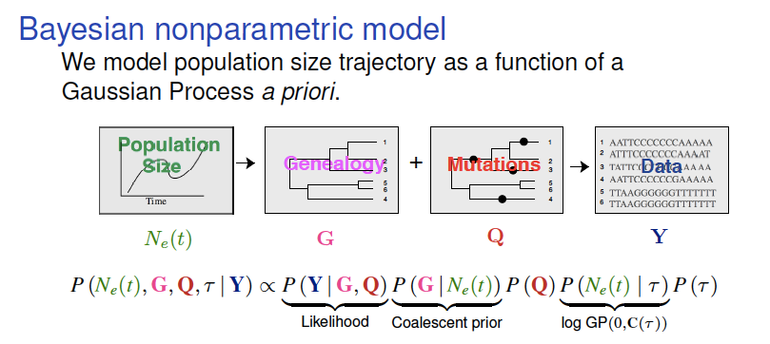
Bayesian phylodynamic methods: BEAST, BEAST2, phylodyn
Challenge 1: computation!
Challenge 2: interpretation and prediction (model assumptions)

Slide 27
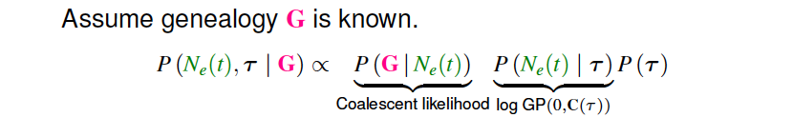

Slide 28
Tractable alternative to analyze SARS-CoV-2
Avoid MCMC integration
Consider local preferential sampling
Palacios and Minin UIA, 2012
Karcher, MD, Palacios JA, Bedford T, Suchard MA and Minin, VN, PLOS CompBiol. 2016
Karcher, MD, Palacios JA, Lan S, and Minin, VN, MER 2017

Slide 29
Populations are structured and sequences are preferentially sampled

Slide 30
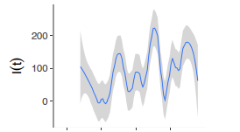
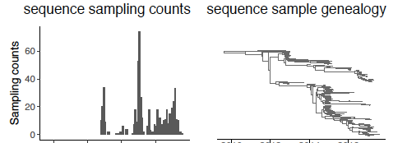
Preferential Sampling
Sampling log-likelihood:

Slide 31
Bayesian phylodynamic methods: BEAST, BEAST2, phylodyn
Challenge 1: computation!
Challenge 2: interpretation and prediction (model assumptions)

Slide 32
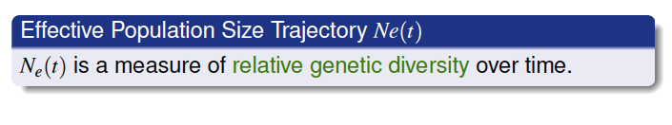
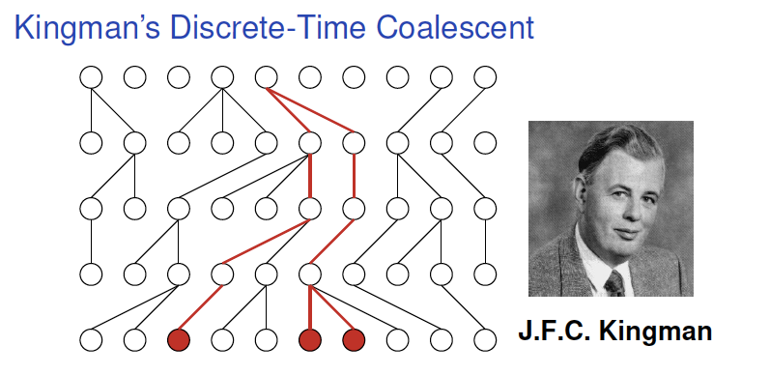
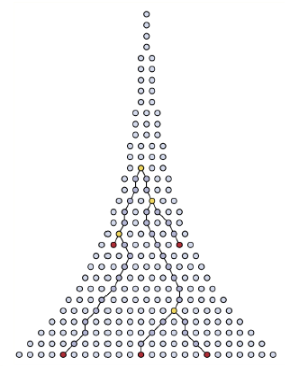
Constant population
Exponential Growth
Assumptions: Constant variance in offspring distribution and neutral evolution

Slide 33
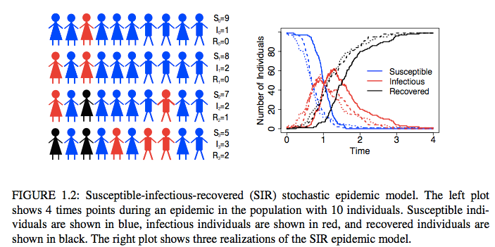
Structured coalescent SIR
Figure credit: Vladimir Minin

Slide 34
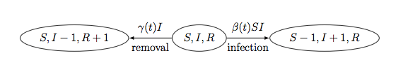
Structured coalescent SIR
Volz et al., Genetics 2009

Slide 37
https://ourworldindata.org/

Slide 56
Source: https://github.com/CSSEGISandData/COVID-19/tree/master/csse_covid_19_data/csse_covid_19_time_series

Slide 58
Source: https://github.com/CSSEGISandData/COVID-19/tree/master/csse_covid_19_data/csse_covid_19_time_series

